Slide 1

RAJAMAHENDRI INSTITUTE OF ENGINEERING AND TECCHNOLOGY
Department of
ELECTRONICS AND COMMUNICATION ENGINEERING
Under the Guidance of
Dr. CH. SURYABABU,
M.Tech, Ph.D.
HOD & Professor
PRESENTED BY: J. DHEERAJ 21MD1A0429
G. BHARATH CHANDU 21MD1A0422
N. SATISH CHANDRA 22MD5A0407
M. K. JAGADIESHESWAR 21MD1A0440

Slide 2
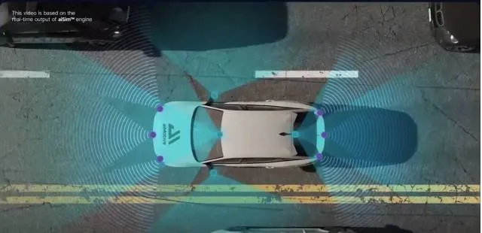
TITLE
Mean Based Approach To Omnidirectional Pathfinding Algorithm Using Single Ultrasonic Sensor for Robotic Car

Slide 3
Contents
Abstract
Introduction
Problem statement & challenges
System components
Working mechanism
Block diagram
Existing methods & limitations
Proposed method
Advantages and future scope
Conclusion

Slide 4
Abstract
We propose an omnidirectional pathfinding system to improve real-time obstacle detection and navigation for autonomous robotic vehicles. By integrating a single ultrasonic sensor, a servo motor, L293D motor driver, our system scans a 180-degree field for better detection and accuracy. Processed data from the sensor allows smooth navigation via a mean-based pathfinding algorithm. This system reduces false positives, optimizes movement, and enables remote monitoring, ideal for applications like search-and-rescue, industrial automation, and hazardous environment exploration.

Slide 5
Introduction
Pathfinding algorithms are crucial in robotics and automation for finding paths and avoiding obstacles.
Existing pathfinding algorithms for ultrasonic sensors are limited by their monodirectional nature, often relying on simple binary decisions (left and right), leading to inaccuracies.
Enhancements to these algorithms aim to improve their accuracy.
These algorithms have applications in the military to reach inaccessible or dangerous areas.

Slide 6
Problem Statement & Challenges
Problem Statement:
In modern robotics and automation, the accuracy and efficiency of pathfinding algorithms are limited by the monodirectional nature of ultrasonic sensors
Often rely on simple binary directional decisions (left and right).
inaccuracies in pathfinding and obstacle avoidance,
Challenges:
Real-time Processing.
Algorithm Enhancement.
Environmental Adaptation.
Reduce false Alarms.

Slide 7
Existing Methods & Limitations
Static ultrasonic sensors provide monodirectional obstacle detection, leading to blind spots and inefficiencies in complex environments.
Signal reflections cause inaccurate readings, requiring frequent path recalculations
Lack of servo motor-driven scanning limits adaptive obstacle detection capabilities.
Absence of motor control mechanisms (e.g., L293D driver) results in imprecise movement and inefficient navigation.

Slide 8
Proposed Method
The system integrates an ultrasonic sensor mounted on a servo motor for 180° scanning, improving obstacle detection.
A mean-based algorithm processes the data, reducing false positives and optimizing path selection.
The L293D motor driver ensures precise control of the robot's movements.
Enhanced navigation makes it suitable for industrial, rescue, and autonomous applications.
This approach provides better accuracy and efficiency compared to traditional systems.

Slide 9
System Components
Arduino Uno
L293D Motor Driver
Chassis
Motor & wheels
Ultrasonic Sensor HC-SR04
Servo motor
Jumper wires
Lcd display
Transformer

Slide 10
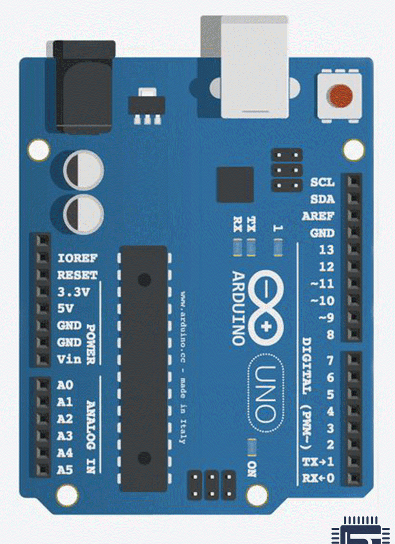
System Components
1. Arduino Uno
Digital Pins (D₀ – D₁₃)
Analog Pins (A₀ – A₅)
Power pins
V_{in} , 3.3v,5v,ioref,reset
Processor: Atmega328P
PWM pins: 3,5,6 , 9,10,11
UART PINS: D₀,D₁

Slide 11
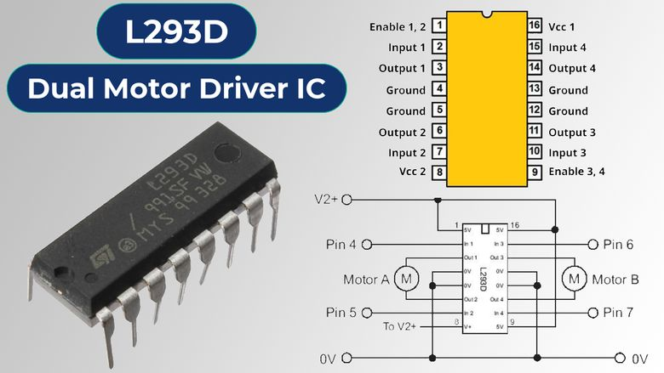
System Components
2. L293D Motor Driver
The L293D is a popular motor driver IC used to control the direction and speed of DC motors. It contains two H-bridge circuits, allowing it to control two DC motors simultaneously

Slide 12
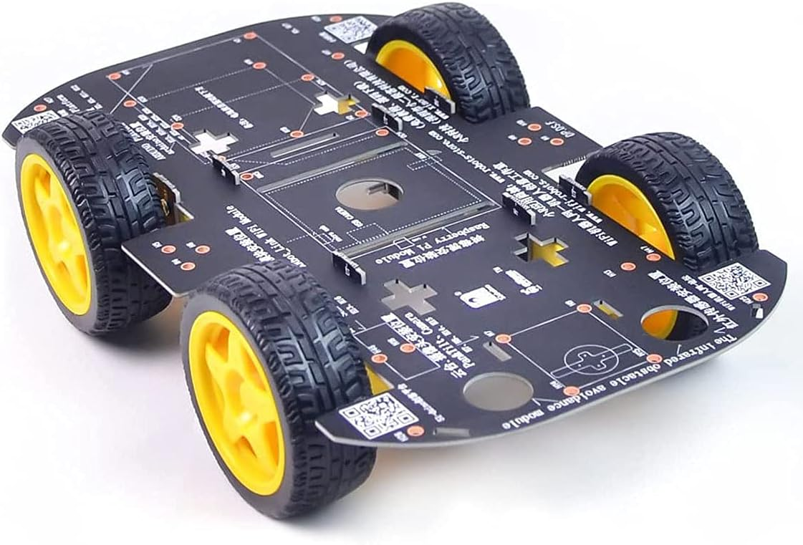
System Components
3. Chassis
The chassis is the structural framework of a vehicle, providing support for all other components, including the body, engine, and wheels. It ensures stability and strength, allowing the vehicle to function properly.

Slide 13
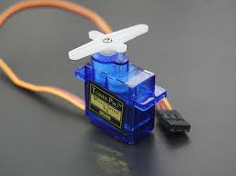
System Components
4. servo Motor
A servo motor is a rotary actuator that allows for precise control of angular position, velocity, and acceleration. It consists of a motor, a position sensor, and a control circuit. Servo motors are commonly used in robotics, automation, and control systems to perform tasks requiring precise positioning.

Slide 14
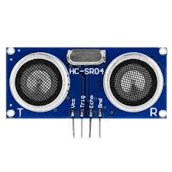
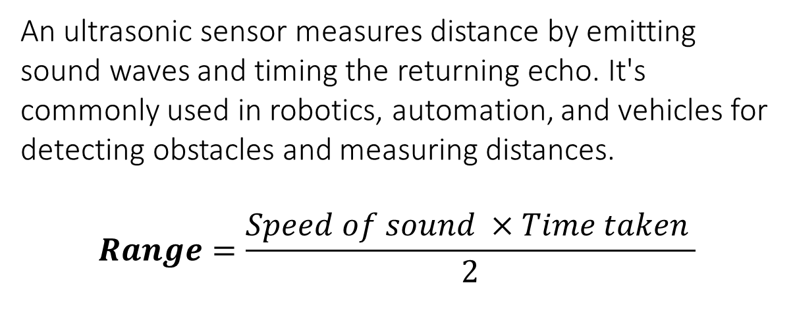
System Components
5. Ultra Sonic Sensor HC-SR 04
An ultrasonic sensor measures distance by emitting sound waves and timing the returning echo. It's commonly used in robotics, automation, and vehicles for detecting obstacles and measuring distances.
$$Range=\frac{Speed of sound ×Time taken }{2}$$
Specification:
Operating voltage: 5V
Frequency : 40KHz
Measuring range: 2cm to 400cm

Slide 15
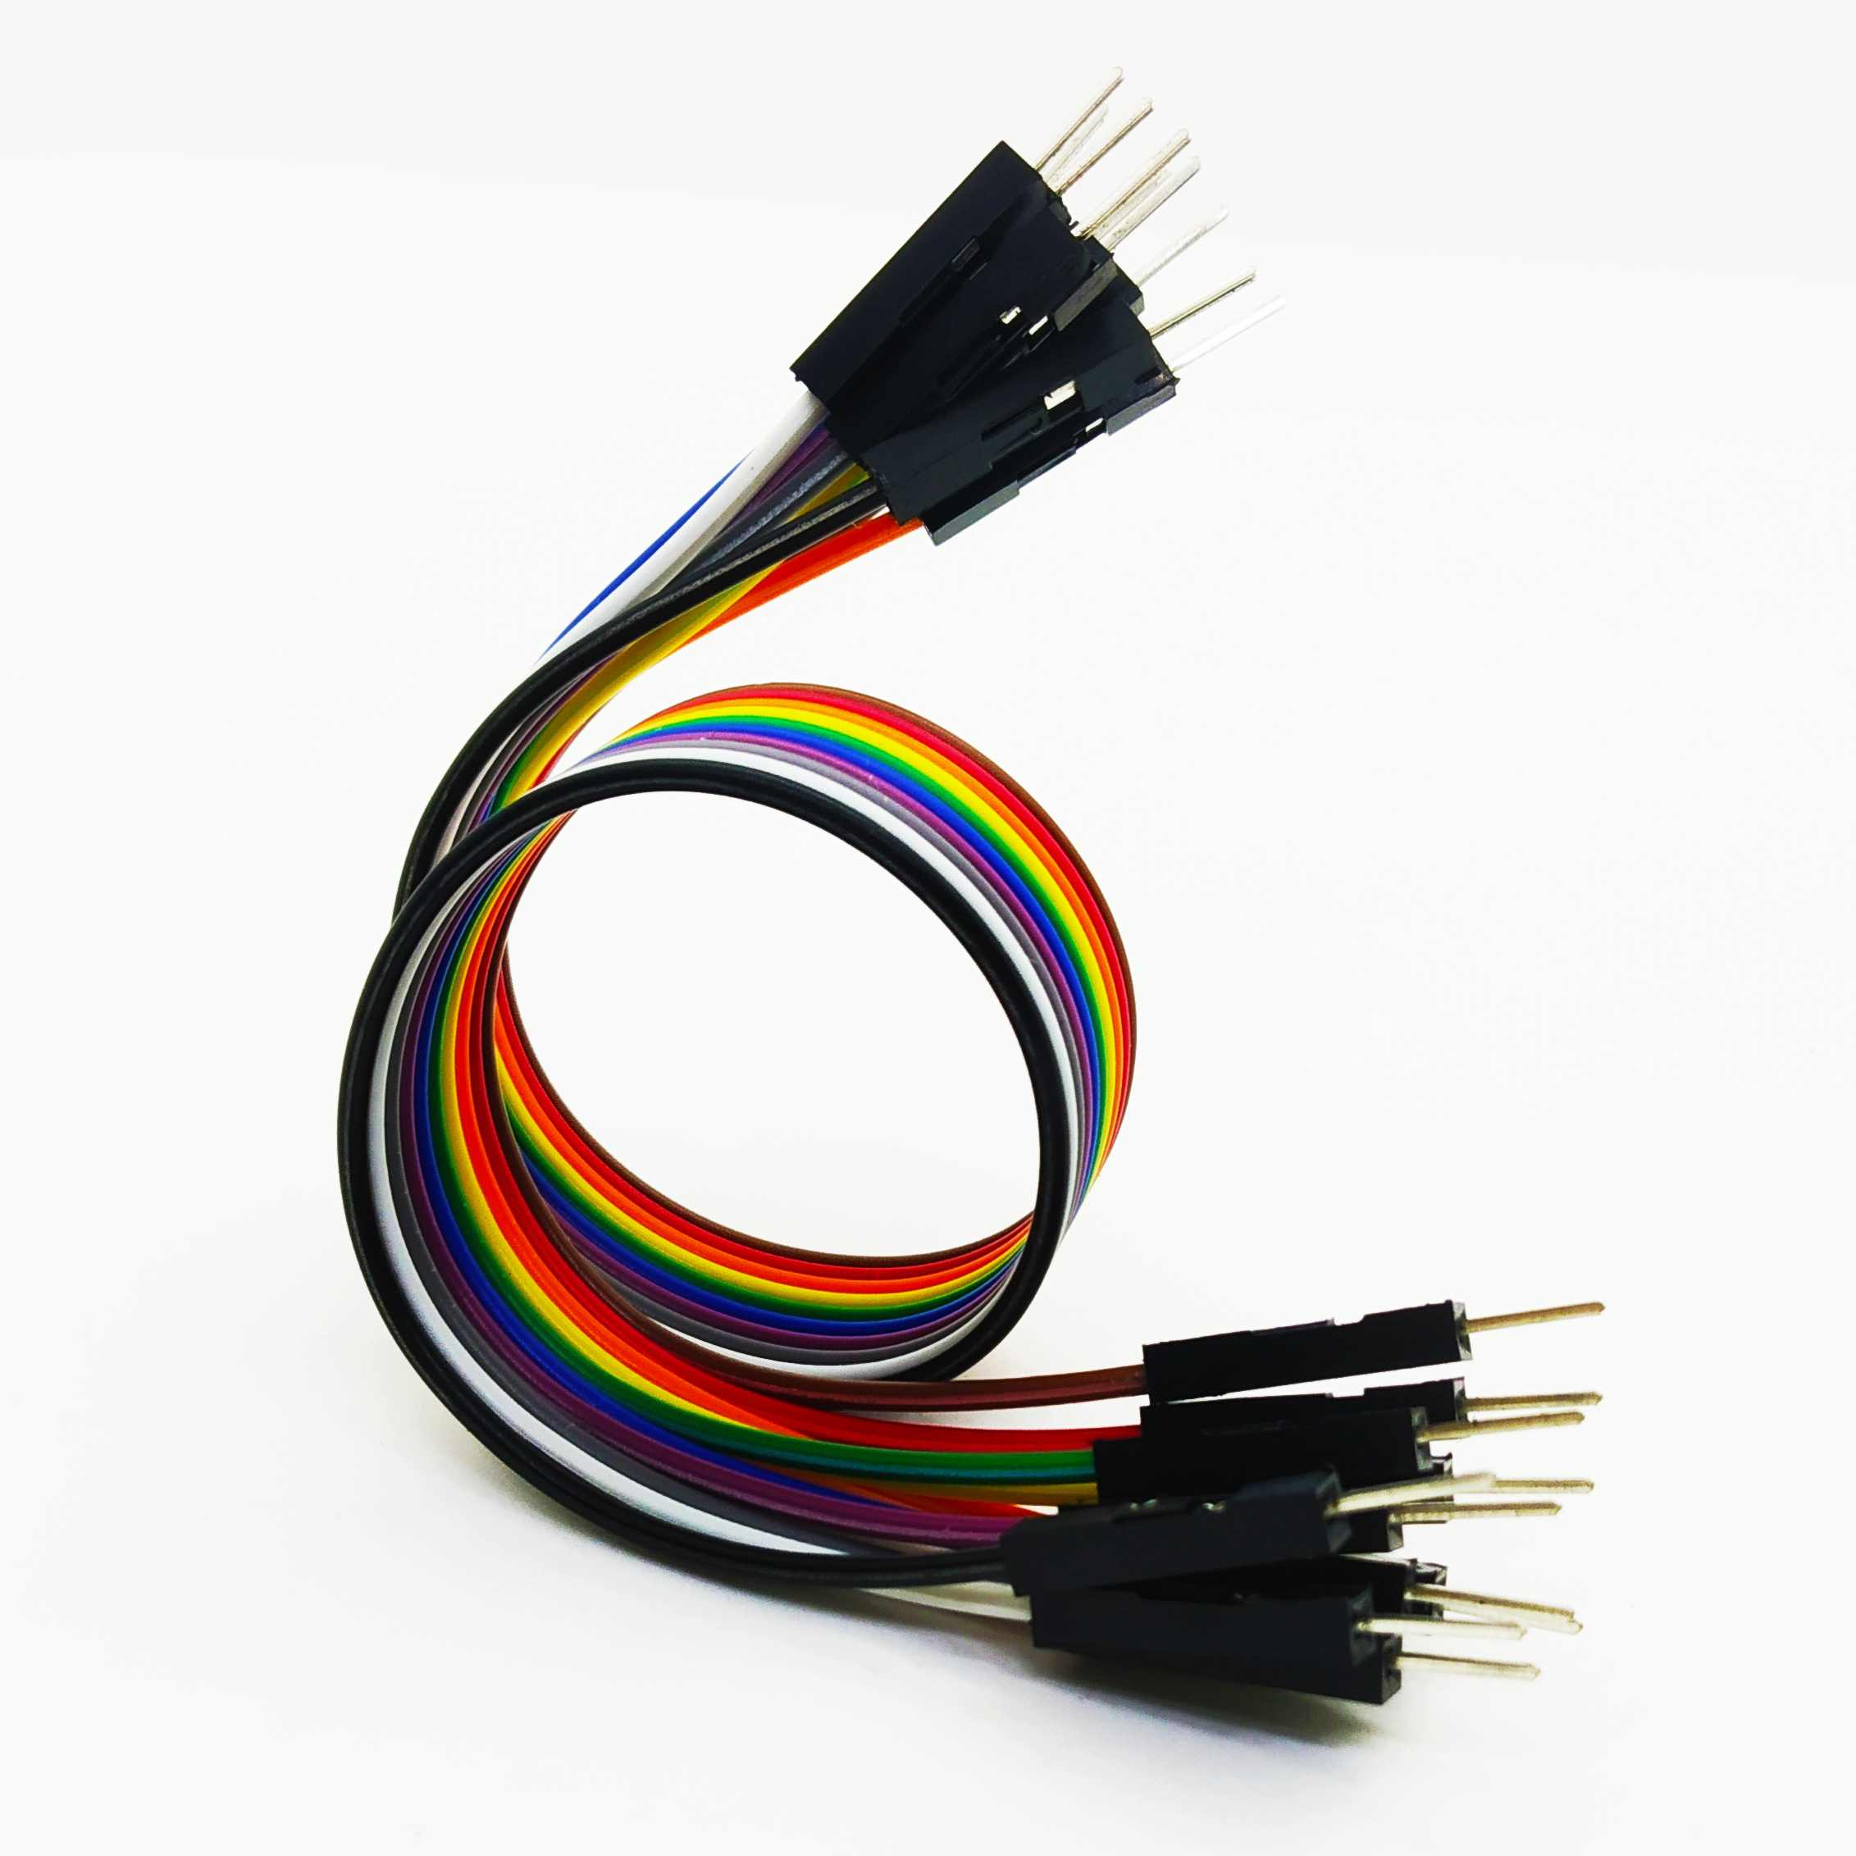
System Components
6. Jumper Wires
Jumper wires are flexible connectors with pins at each end, used to link components on breadboards or prototyping tools. Available in various lengths and colors, they simplify circuit creation and testing, making them essential for quick prototyping.

Slide 16
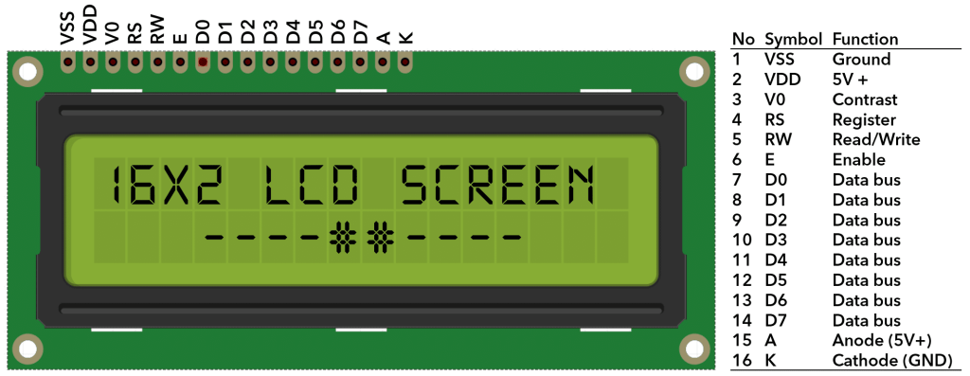
System Components
7. LCD display
Size: A 16x2 LCD display can show up to 32 characters (16 per row).
Operation Modes: Supports both 4-bit and 8-bit communication modes for flexibility in microcontroller connections.
Backlight: Equipped with an LED backlight for better visibility in low-light environments.
Contrast Adjustment: Includes a pin (V0) for connecting a potentiometer to adjust screen contrast.
Applications: Widely used in embedded systems, consumer electronics, and industrial machines.

Slide 17
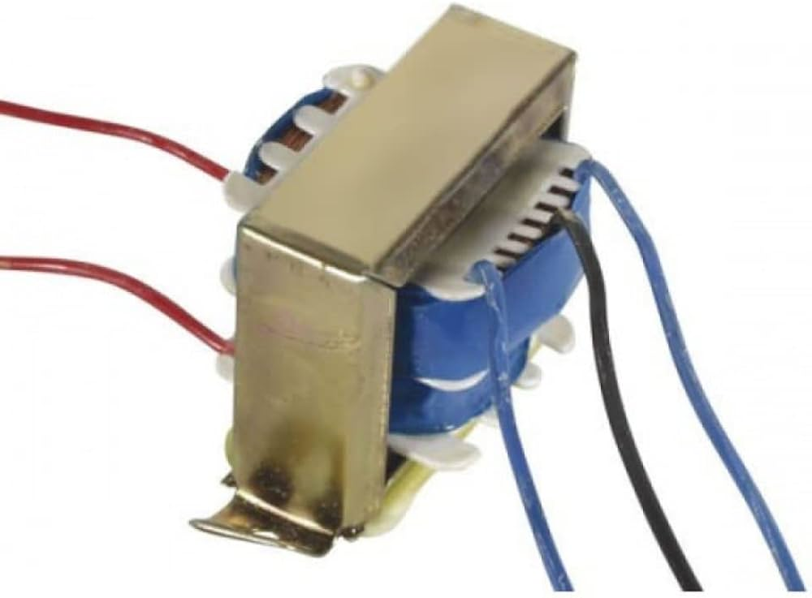
System Components
8. Transformer
A 12-0-12 center-tapped transformer is a type of step-down transformer commonly used in electronics projects.
Primary Voltage: Typically operates at 220V or 230V AC input.
Secondary Voltage: Provides three output voltages: 12V, 0V (center tap), and another 12V. The voltage across the two outer terminals is 24V AC.

Slide 18
Interfacing of Components
Sensors
LCD
Base Board
Power supply board
Transformer
12-0-12
P_{in}
Arduino uno
12v
0v
12v
12v
3.3v
5v
P_{in}
Gnd
Motors

Slide 19
Working Mechanism
Normal Detection Method:
Utilizes an ultrasonic sensor to measure the distance between the car and the nearest object in its line of sight.
This method is not omnidirectional, meaning it only detects objects directly in front of the sensor.
Most commonly used and does not involve the use of a servo motor
Intensive Detection Method:
Employs a servo motor to rotate the ultrasonic sensor, providing a 180-degree view for omnidirectional detection
Sensor starts at 0 degrees (extreme left) and rotates to 180 degrees (extreme right) in 3-degree steps
Collected data is analyzed to determine the subsequent actions

Slide 20
Block Diagram
Power supply
16*2 LCD
Arduino Uno
Servo motor
Ultrasonic Sensor
L293D motor driver
M1
M2

Slide 21
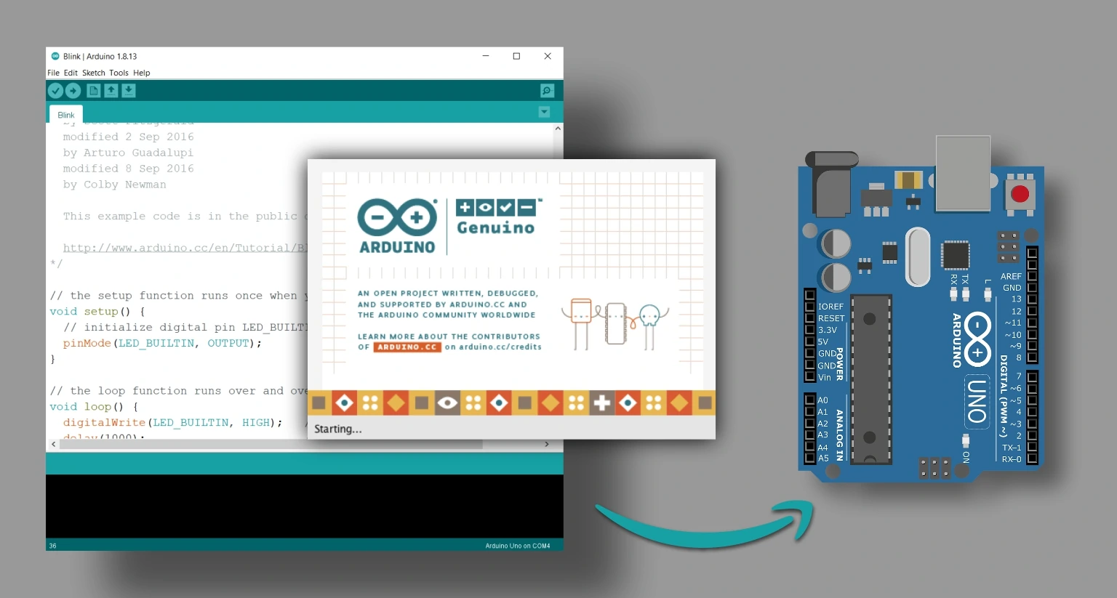
Software's Used
Arduino IDE (1.8.X)
Arduino IDE (Integrated Development Environment) is a platform used for writing, compiling, and uploading code to Arduino boards.
Features: Simple user interface, open-source nature, supports multiple programming languages (mainly C and C++).
Compatibility: Works on Windows, macOS, and Linux systems.
Applications: Widely used for prototyping, robotics, IoT projects, and educational purposes.

Slide 22
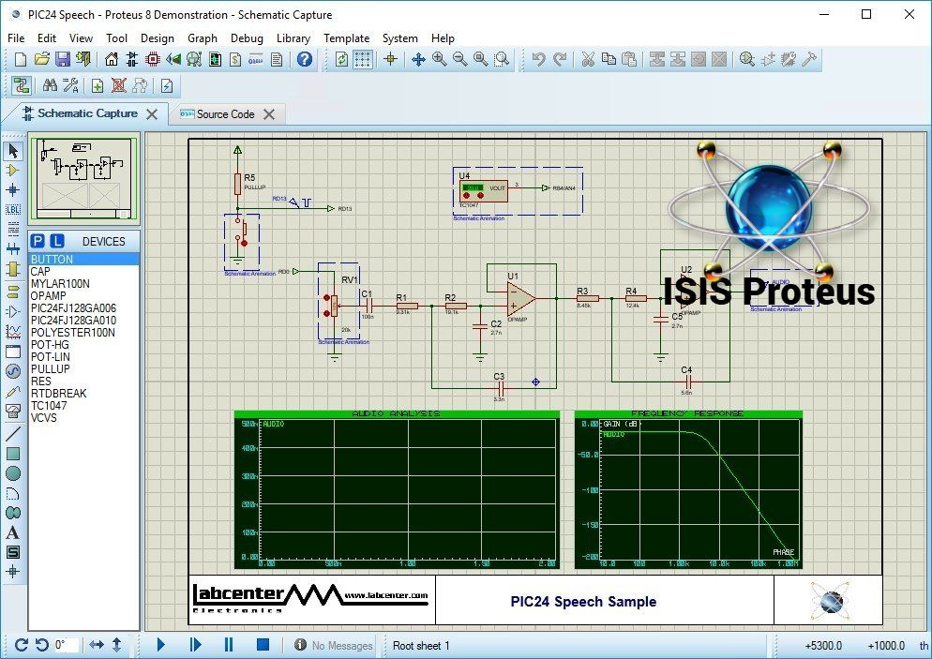
Software's Used
Proteus - ISIS
Proteus ISIS (Intelligent Schematic Input System) is a tool for designing and simulating electronic circuits.
Features: Offers a vast library of components, real-time simulation, and integration with microcontroller programming.
Applications: Used for circuit design, testing, and educational purposes, especially in embedded systems and IoT projects.
Part of Proteus Suite: Bundled with ARES for PCB design, making it a comprehensive electronic design solution.

Slide 23
Advantages & Future Scope
Advantage:
Enhanced Mobility
Time Efficiency
Efficient Pathfinding
Energy Efficiency
Future Scopes:
Disaster Response
Smart Vehicles
Space Exploration

Slide 24
Conclusion
The integration of an ultrasonic sensor, servo motor, and L293D motor driver offers a sophisticated solution for autonomous robotic navigation. It enhances obstacle detection with broader coverage, ensures precise movement control, and reduces navigation errors. A mean-based algorithm improves path selection accuracy by minimizing false positives. Future developments could include AI-driven obstacle recognition, adaptive navigation through machine learning, and additional sensors for greater reliability. This innovative system is cost-effective and ideal for applications in industrial automation, autonomous vehicle navigation, and hazardous environment exploration.

Slide 25
Thank you

